Slide 1



Tracking an Object in Self-Recorded Videos using CoTracker‑v3
Name: Tiwari Manish Rakeshbhai
Under the Guidance of Richa Thakur

Slide 2
overview
Introduction
Dataset and preprocessing
Methods and model
Results and visualizations
Takeaway & References

Slide 3
Introduction
Project: Tracking an Object in Self-Recorded Videos using CoTracker-v3
Task: Track a ball in self-recorded videos under occlusion and motion blur
Importance: Real-time tracking is useful for robotics, AR/VR, and monitoring
Objective: Extract continuous trajectories and visualize object movement
Model: CoTracker-v3 enables robust transformer-based tracking

Slide 4
Dataset & Preprocessing
Dataset: Self-recorded videos,varied backgrounds and lighting
Objects: Ball in motion (user-specified initial point)
Preprocessing: Resize frames, normalize frame rate, manually annotate initial points
Purpose: Ensure accurate and consistent input for CoTracker-v3
Visual: Sample frames with initial points highlighted

Slide 5
Methods & Models
Model: CoTracker-v3 (Transformer-based space-time attention)
Input: Video frames + manually selected points
Output: Trajectories + visibility masks
Hyperparameters: Grid size = 20, object-centric crop = 50×50 px,
Pipeline: Video → Preprocessing → CoTracker-v3 → Trajectories → Visualization

Slide 6
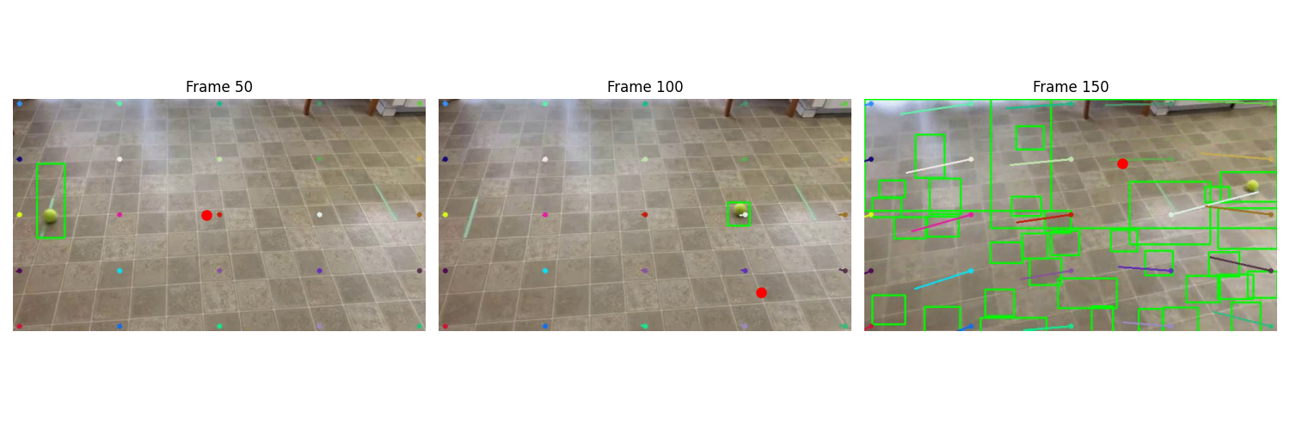
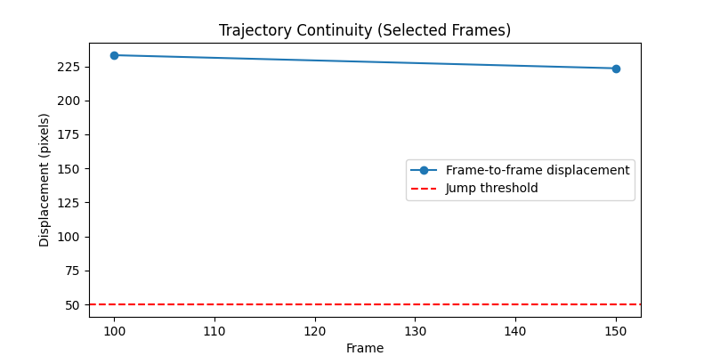
Results & Visualization
Successful tracking from frame 50 onward
Displacement analysis: Frame 50→100 = 233.24 px, Frame 100→150 = 223.61 px
Visual: Plot 1 – Displacement vs Frame | Plot 2 – Trajectory X/Y over frames

Slide 7
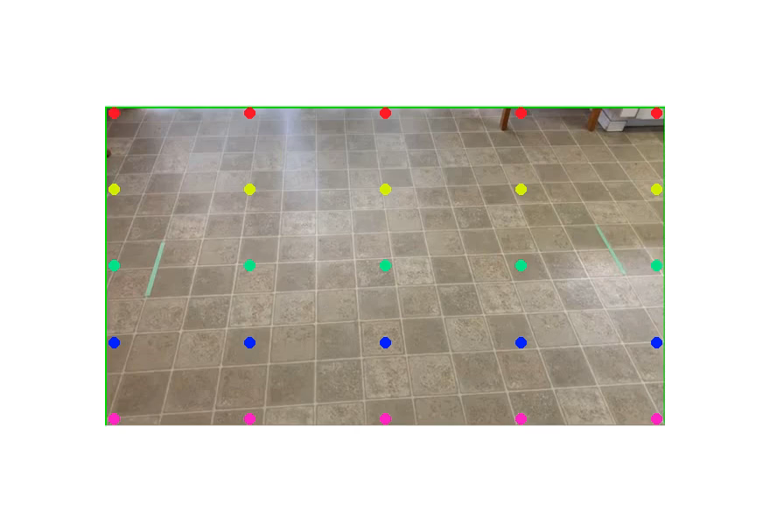
Video of the output

Slide 8
Takeaways & References
vCoTracker-v3 robustly tracks moving objects in real-world self-recorded videos
Continuous trajectory extraction even under partial occlusion
Limitations: No multi-object or backward tracking
Future Work: Add comparison with baseline trackers & extend to multi-object tracking
References:
  Girdhar et al., CoTracker: It’s Better to Track Together. CVPR 2023. arXiv:2301.03281
  Arxiv: https://arxiv.org/abs/2307.07635
  CoTracker GitHub: https://github.com/facebookresearch/cotracker

